Slide 1
Design a Lidar for Precision Agriculture
Presented by
Bipin Raut
Fatima Tuz Zafrin Tuli
Date:05/02/2018
Active Sensors in Remote Sensing
EE 792

Slide 2
Objective
Determine the health condition of vegetation from reflectance feature using UAV based Lidar
Get cost effective and stable Lidar design for agricultural application

Slide 3
Optical sensing in Precision agriculture
Used within agriculture to measure variability within soil and vegetation
most common bands used are the red and NIR bands as the reflectance of these wavelengths can be correlated to plant physiology.
In healthy actively growing plants blue light and red light from the visible spectrum strongly absorbed by the plant chlorophyll pigment inside the leaf cell chloroplasts, to provide energy for photosynthesis.
Near Infra-Red Light (NIR) strongly reflected in healthy actively growing plants. healthy plants display a low red light but high NIR reflectance.
Plants under stress will absorb less red light as the chlorophyll activity decreases causing a decrease in NIR reflectance.

Slide 4
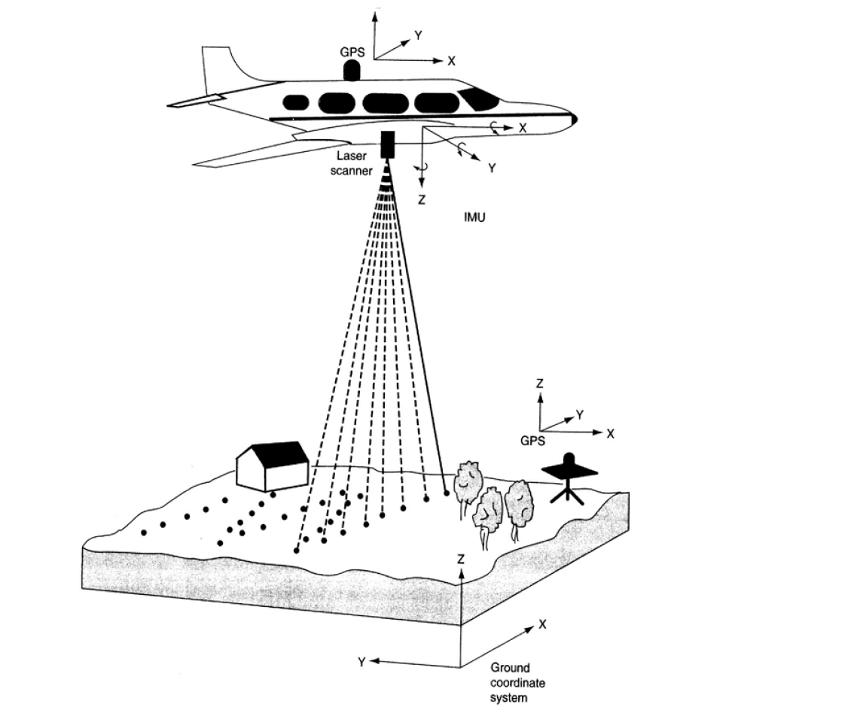
Advantages of Lidar in precision agriculture:
Satellite imagery provide data for anywhere on the planet but often be affected by cloud cover.
Airborne imagery using aircraft platforms including unmanned aerial vehicles (UAVs) can provide imagery at resolutions of between 25cm to 3m
is less likely to be disadvantaged by atmospheric conditions.
UAV LIDAR become popular in precision agriculture now-a-days.
Figure 1: Airborne Lidar application in agricultural analysis

Slide 5
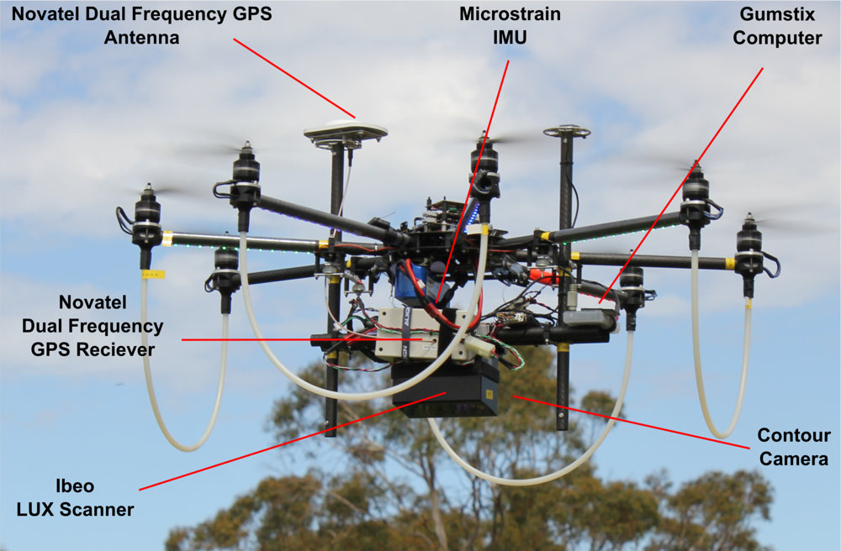
Lidar (Light Detection and Ranging)
a surveying method that measures distance to a target by illuminating the target with pulsed laser light and measuring the reflected pulses with a sensor.
Differences in laser return times and wavelengths can then be used to make digital 3-D representations of the target.
Figure 2: UAV drone Lidar platform
Source-Wikipedia

Slide 6
Considerations on Lidar Design
What type of lidar: Mie, Rayleigh, Raman, resonance fluorescence, DIAL, coherent, direction-detection Doppler, fluorescence, rangefinder, altimeter, HSRL
Bistatic or monostatic?
Biaxial or coaxial?
Up looking or down looking
Wavelength for transmitter and receiver
Tunable or not?
Bandwidth for transmitter and receiver
Frequency stability for transmitter and receiver
Power/energy consideration (especially in space-, balloon- or UAV-borne)
Nighttime or full diurnal capability?
Mobile or not?
Volume, mass, cost, reliability, robustness, operation

Slide 7
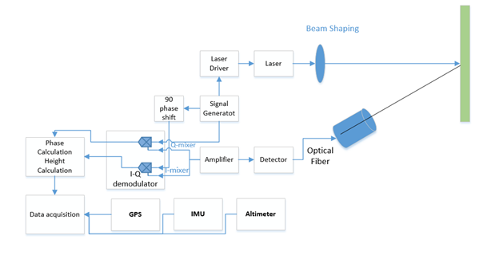
Lidar Architecture
Telescope
Target

Slide 8
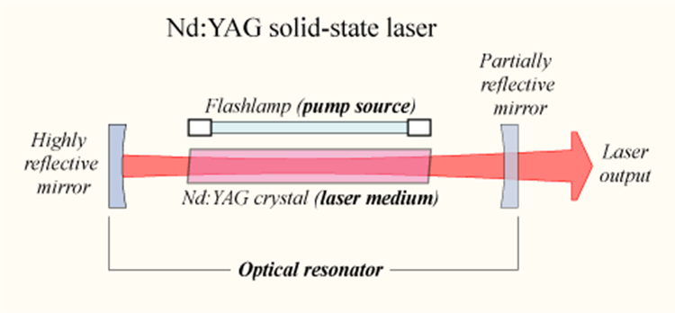
Laser used for Design
Nd: YAG Laser-Pumped Hydrogen Raman Shifter has been chosen as the illumination source.
typically emit light with a wavelength of 1064 nm, in the infrared
operate in both pulsed and continuous mode
operated in the so-called Q-switching mode
Figure 4: Nd:YAG Laser Working principle [https://en.wikipedia.org/wiki/Nd:YAG_laser]

Slide 9
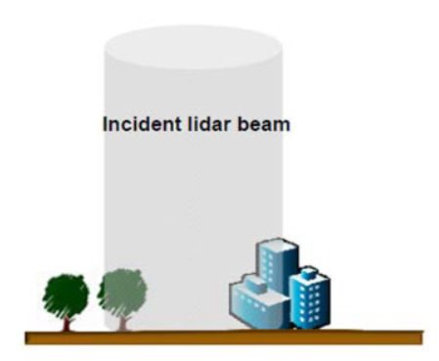
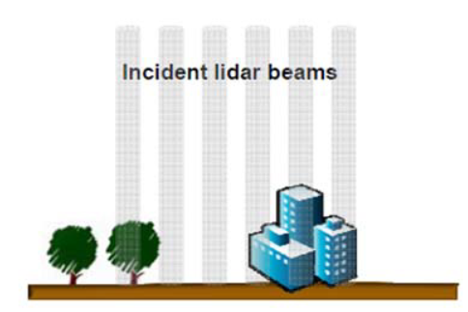
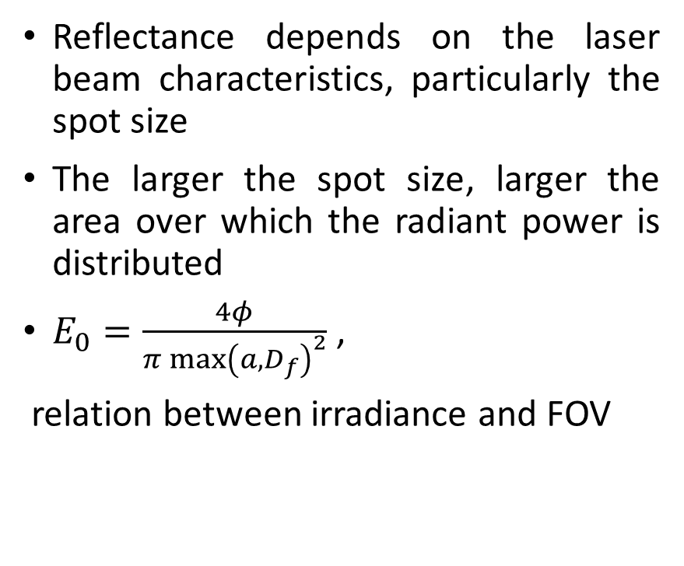
Laser Beam Profile
Reflectance depends on the laser beam characteristics, particularly the spot size
The larger the spot size, larger the area over which the radiant power is distributed
$E_{0}=\frac{4φ}{π{\max\left(a,D_{f}\right)}^{2}}$ ,
relation between irradiance and FOV
Figure 6: Difference between large and small FOV
(Large FOV usually results in a lower S/N)

Slide 10
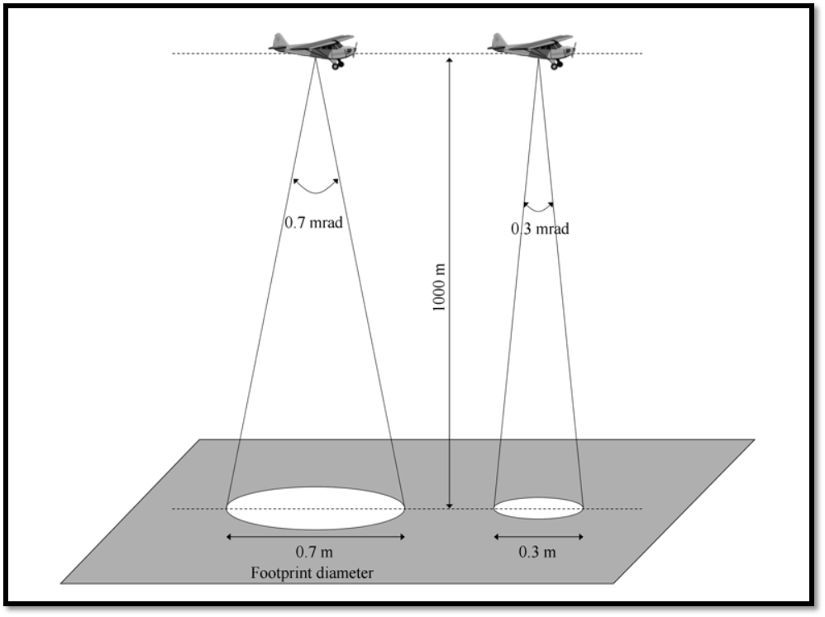
Beam divergence by Laser
“beam divergence” refers to the increase in beam diameter that occurs as the distance between the laser instrument and a plane that intersects the beam axis increases.
Typical beam divergence settings range from 0.1 to 1.0 milliradian.
Figure 5: Illustration of LIDAR beam divergence.

Slide 11
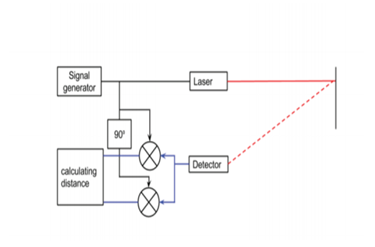
Quadrature Phase Detection
a signal generator is used to generate a signal s1 with a certain waveform and frequency (f).
emitted laser light is reflected by an object at a certain height (h) from the UAV and is measured by a photodiode serving as a detector

Slide 12
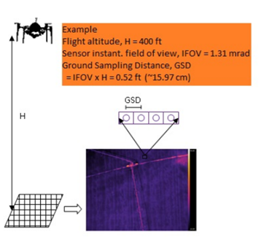
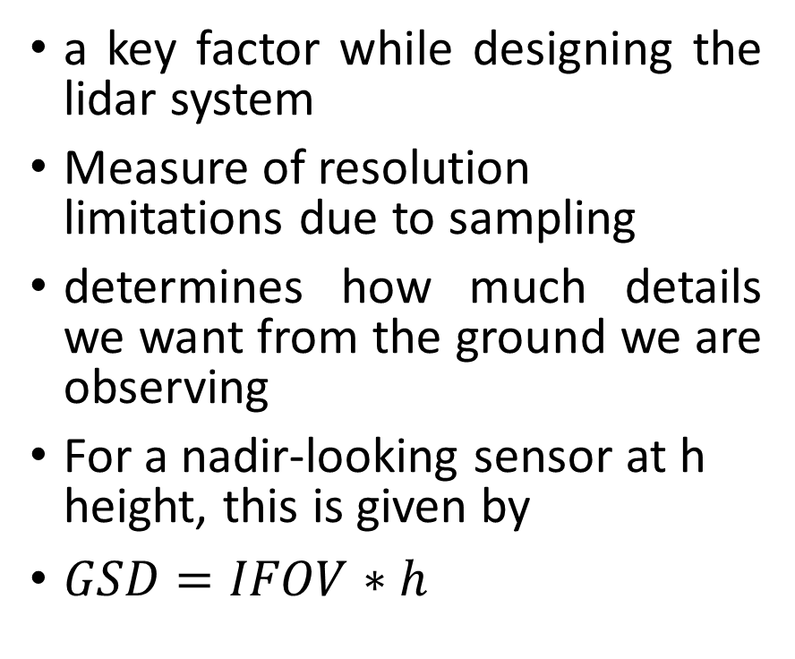
Ground-projected instantaneous field of view (GIFOV)
a key factor while designing the lidar system
Measure of resolution limitations due to sampling
determines how much details we want from the ground we are observing
For a nadir-looking sensor at h height, this is given by
$GSD=IFOV∗h$
Figure 7: Ground Sampling Distance

Slide 13
Photo Detector
Types of Photodetectors
Photodiode
PIN diode
Avalanche Photodiode- APD
Photomultiplier Tube (PMT)
Charge Coupled Device – CCD
Photoresistors
Photo Transistors
Consideration in Photodetector Selection
Photosensitivity
Frequency Response
Noise-equivalent Power

Slide 14
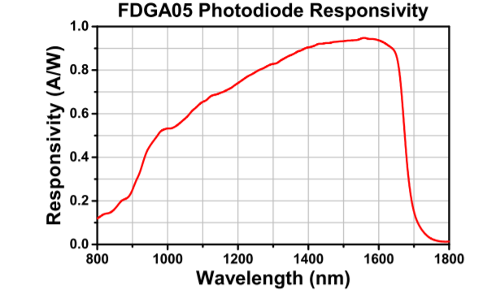
Selected Photodiode in Design
Although there are a lot of PIN diode available for NIR wavelength Thorlabs FDGA05, InGaAs, is selected for this analysis.
This photodiode has high rise and fall time of 2.5 ns.
wavelength ranges from 800-1700nm
Figure 8: Responsivity of FDGA05

Slide 15
Other Necessary components
GPS
Inertial Measurement Unit
Laser altimeter

Slide 16
Designed Parameters Specification
S. N | Properties
 | Proposed Distance between Surface and UAV(approx.) | 100m
 | Laser Wavelength | 1064nm
 | Pulse Energy | 0.6µJ
 | Pulse Repetition Frequency | GHz range
 | Ground Sampling Distance | 15cm
 | Receiver wavelength | 800-1800nm
 | Telescope Diameter (approx.) | 2.5cm

Slide 17
Approximate Cost Estimation of the proposed design
S. N | Components | Unit | Prices ($) per unit | Price
1. | VGEN-SP-NL-25-10 | 1 | 4000 | 4000
2. | FDGA05 | 1 | 103 | 103
3. | Telescope | 1
4. | MTK3339 (GPS) | 1 | 29.95 | 29.95
5. | LSM303DLHC (Compass + Accelerometer) | 1 | 14 | 14
6. | BMP280 (Altitude Sensor) | 1 | 9.95 | 9.95
7. | AD8333 (Demodulator) | 1 | 352 | 352
8 | Ada 4817 (Amplifier) | 2 | 5 | 10
9 | OPA 541 (Amplifier) | 1 | 15 | 15
10 | Signal Generator (ADF4355) | 1 | 110.88 | 110.88
Total |  |  |  | $4634.8

Slide 18
Conclusion
This project provides general overview Lidar design to determine the health condition of the Plant
proposed Lidar design gives the resolution of 15 cm
design specification has been made taking into consideration health hazards
To maintain eye safety pulse energy has been limited to 0.6 micro joule
The design considers all the parameters that could un stabilize the system, so proper control and management is necessary for stability issue.

